Slide 1
COEN160 OO Analysis, Design, Programming
No explicit attendance list, but …
If you are unable to come write me an email
Encourage to work together, but everybody is submitting his/her own solution
No plagiarism at all

Slide 2
COEN020 Introduction to embedded systems
Everybody has to show me your working solution
If you have not presented your working solution, but you submitted it -25 pts penalty
Late submission is -10 pts per day
Never miss a lab session because…
Final lab grades will be curved

Slide 3
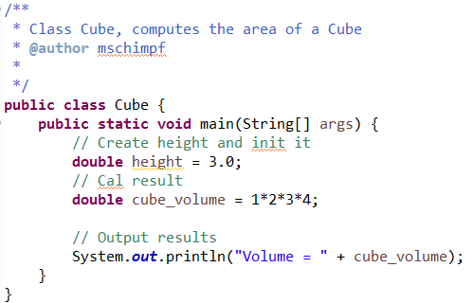
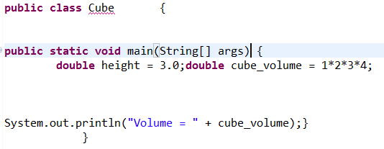
COEN020 Introduction to embedded systems
Grading
90 % for correctness
10 % Style/indentation/commenting
Style/Indentation/Commenting
Good Bad (-10%)

